Slide 1
Cystotomy
Isolate the bladder from the rest of the abdominal cavity by placing moistened laparotomy pads beneath it. Place stay sutures on the bladder apex and trigone to facilitate manipulation Make a longitudinal incision in the ventral or dorsal aspect of the bladder, away from the ureters and urethra, and between major blood vessels. Remove urine by suction or perform intraoperative cystocentesis before cystotomy if suction is not available. Excise a small section of the bladder wall adjacent to the incision to submit for aerobic culture. Check the bladder apex for a diverticulum, and excise it if necessary. Examine the mucosa for defects, and pass a catheter down the urethra to check for patency.

Slide 2
Cystotomy
Close the bladder in a single layer using a continuous suture pattern with absorbable suture material. For a two-layer closure, suture the seromuscular layers with two continuous inverting suture lines (e.g., Cushing, followed by Lembert;). If the dog has severe bleeding tendencies, consider suturing the mucosa as a separate layer with a simple continuous suture pattern.

Slide 3
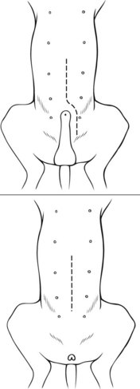
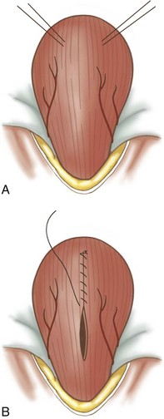
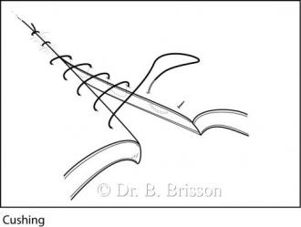
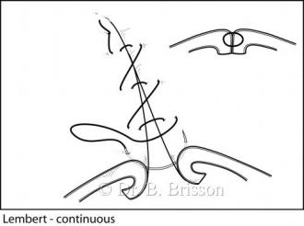
Cystotomy

Slide 4
Cystotomy
- Postoperative care
1- systemic antibiotic
2- bladder drainage by using catheter
3-remove suture
- Complication
1-hemorrhage
2-peritonitis
3- prolapse abdominal contents

Slide 5
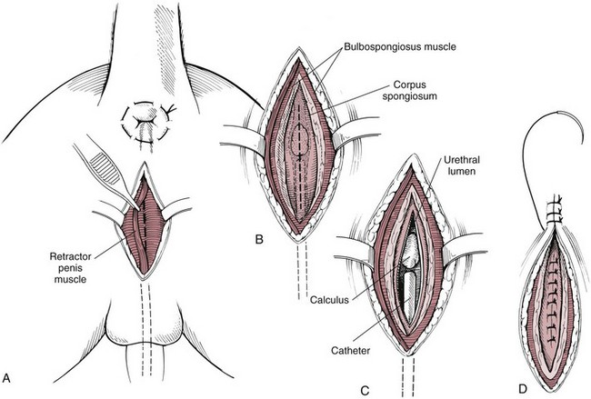
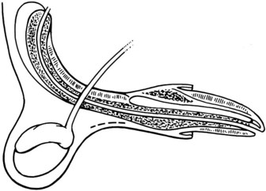
Urethrotomy
- Urethrotomy is performed in male dogs to remove urethral calculi.
1- Prescrotal urethrotomy.
2- Perineal urethrotomy

Slide 6
urethrostomy
Urethrostomy is the creation of a permanent fistula into the urethra; it is generally performed for irreparable or recurrent urethral stricture, or to prevent repeated obstruction (e.g., feline idiopathic cystitis
Indications
1-urethral stenosis
2-calculi that cannot be removed by urethrotomy.
3-recurrent obstructive calculi.
4-urethral or penile neoplasia or severe trauma.
5-preputial neoplasia requiring penile amputation.

